Slide 1
Capstone Project
CREDIT CARD DEFAULTER SELF PROJECT BY IRSHAD

Slide 2

Let’s Catch the Defaulters
1.Defining the problem statement
2.EDA and feature engineering
3.Feature selection
4.Prepraing Dataset for modelling
5.Applying model
6.Model selection and Validation

Slide 3
DATA PIPELINE
Data Processing 1: In this first part we have removed unnecessary features . Since there were nearly many columns with all null values
Data Processing 2: In this part we manually go through each features selected from part 1
EDA: In this part we do some exploratory data analysis on the feature selection on the above parts by using some graphs and models we get the conclusion of the problem statement.
Create the model: Finally , in this part we create some models , Creating the models is not easy task. It’s also an iterative process . we show how to start with a simple model , then add new complex models to get the conclusion of the problem statement.

Slide 4
DATA SUMMARY
The dataset contains the following information of 30000 customers:
DEFAULT - Default payment next month (Yes=1, No=0)
LIMIT_BAL - Amount of the given credit (INR)
SEX - Gender (1 = male; 2 = female)
EDUCATION - Education (1 = graduate school; 2 = university; 3 = high school; 4 = others)
MARRIAGE - (1 = married; 2 = single; 3 = others)
AGE - (year)

Slide 5
DATA SUMMARY
PAST_PAY - History of repayment status
PAST_PAY1 = the repayment status in September 2005
PAST_PAY2 = the repayment status in August 2005
PAST_PAY6 = the repayment status in April 2005
- The measurement scale for the repayment status is
-1 = pay duly
1 = payment delay for one month
2 = payment delay for two months
8 = payment delay for eight months
9 = payment delay for nine months and above

Slide 6
DATA SUMMARY
BILL_AMT- Amount of bill statement (INR)
- BILL_AMT1 = amount of bill statement in September 2005
- BILL_AMT2 = amount of bill statement in August 2005
- BILL_AMT6 = amount of bill statement in April 2005
PAY_AMT - Amount of previous payment (INR)
- PAY_AMT1 = amount paid in September 2005
- PAY_AMT2 = amount paid in August 2005
- PAY_AMT6 = amount paid in April 2005

Slide 7
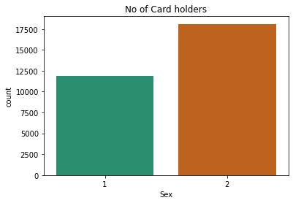
EDA(Exploratory Data Analysis)
Card holder with respect to sex

Slide 8
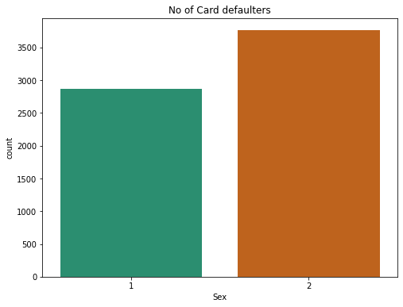
EDA(Exploratory Data Analysis)
Number of defaulter by male and female

Slide 9
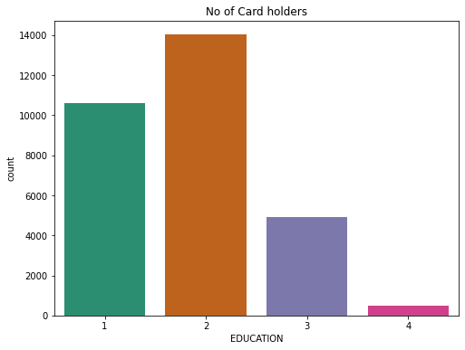
EDA(Exploratory Data Analysis)
Distribution of card on the basis of EDUCATION

Slide 10
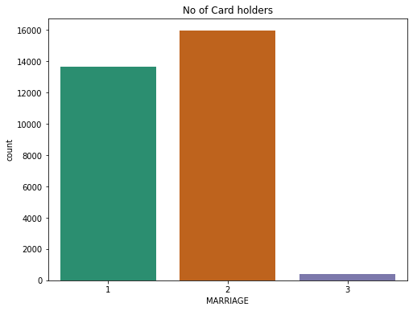
EDA(Exploratory Data Analysis)
Number of card on the basis of Marriage

Slide 11
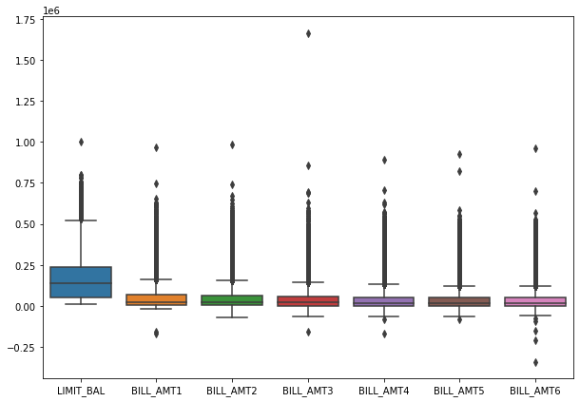
EDA(Exploratory Data Analysis)
Boxplot for Bill Amount vs Limit balance

Slide 12
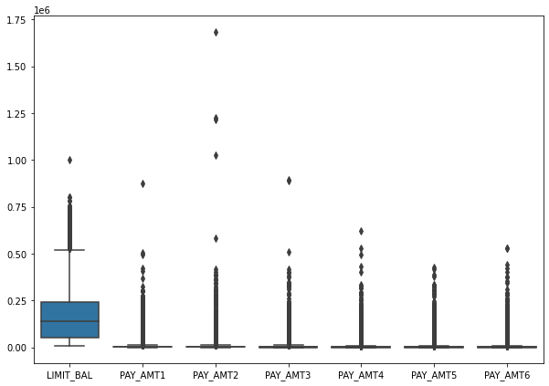
EDA(Exploratory Data Analysis)
Boxplot for Pay Amount vs Limit balance

Slide 13
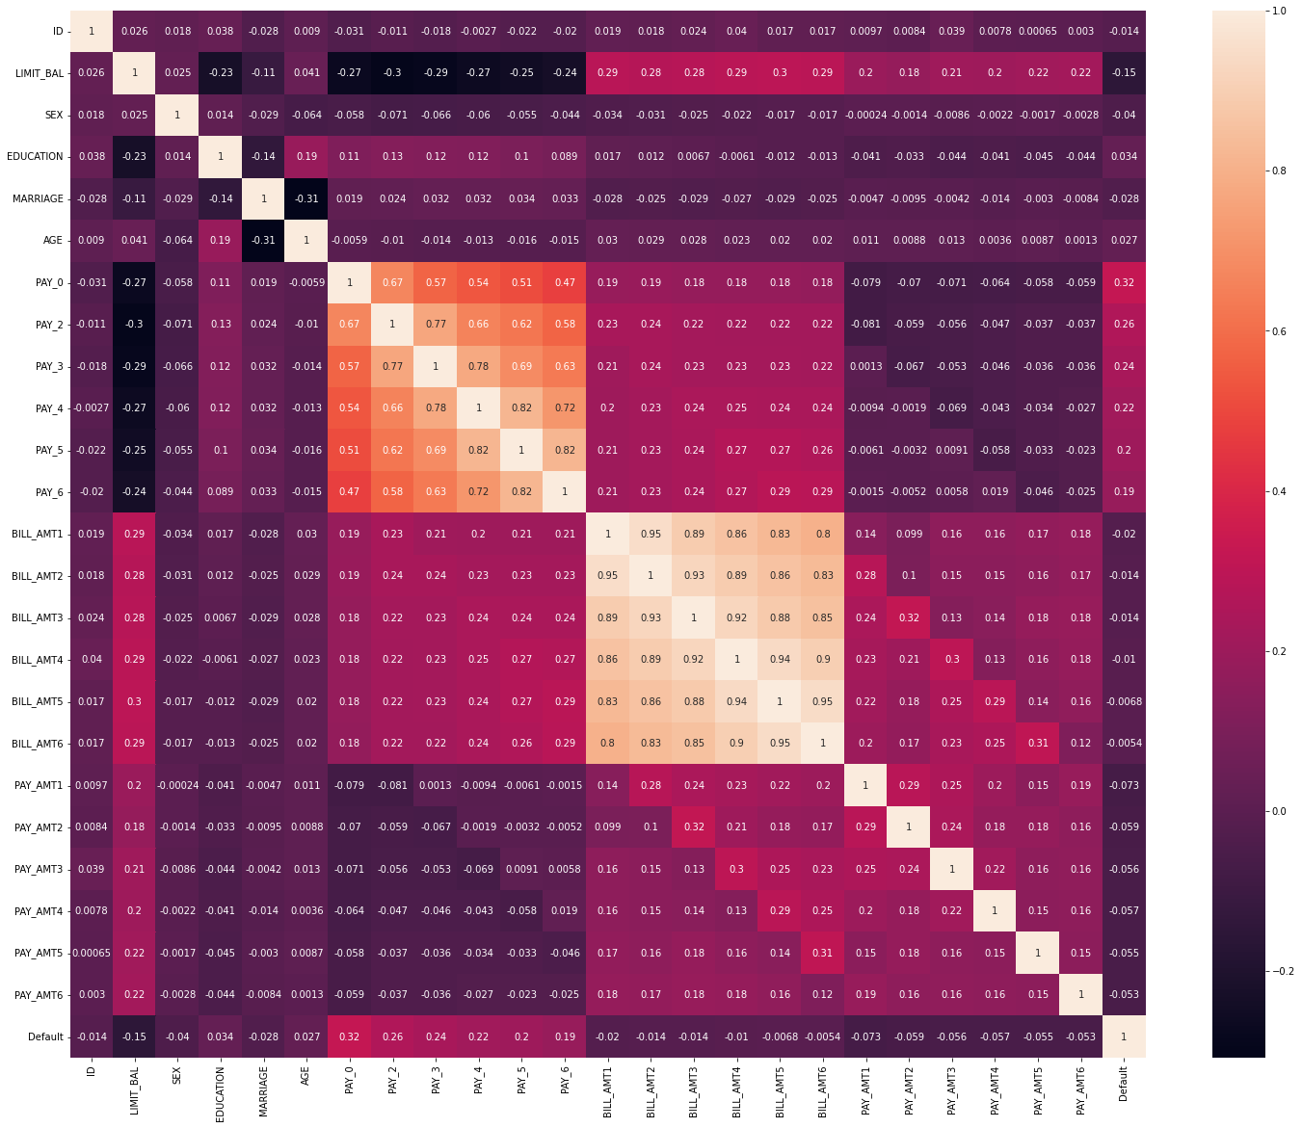
EDA(Exploratory Data Analysis)
Distribution Plot:

Slide 14
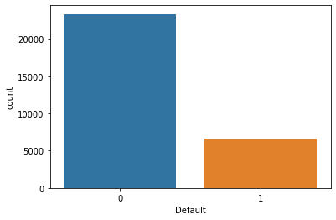
EDA(Exploratory Data Analysis)
Checking if Data is Imbalance:

Slide 15
EDA(Exploratory Data Analysis)
MODELLING:
We apply some algorithm to make a conclusion of the data
1. Logistic Regression:
2. k nearest neighbour
3. Naive bayes
4. Random forest classifier

Slide 16
Logistic Regression:
Precision Recall f1-score Support
0.89 0.15 0.26 7000
0.24 0.94 0.38 2000
Accuracy 0.33 9000
Macro Avg 0.57 0.55 0.32 9000
weighted Avg 0.75 0.33 0.29 9000
The accuracy score of logistic regression is 59.94%

Slide 17
k nearest neighbour
Precision Recall f1-score Support
0.89 0.15 0.26 7000
0.24 0.94 0.38 2000
Accuracy 0.33 9000
Macro Avg 0.57 0.55 0.32 9000
weighted Avg 0.75 0.33 0.29 9000
The accuracy score of K nearest neighbor is 59.01%

Slide 18
Naive baye’s
Precision Recall f1-score Support
0.89 0.15 0.26 7000
0.24 0.94 0.38 2000
Accuracy 0.33 9000
Macro Avg 0.57 0.55 0.32 9000
weighted Avg 0.75 0.33 0.29 9000
Gaussian Naive Bayes model accuracy is 32.79%

Slide 19
Decision tree
Precision Recall f1-score Support
0.89 0.15 0.26 7000
0.24 0.94 0.38 2000
Accuracy 0.33 9000
Macro Avg 0.57 0.55 0.32 9000
weighted Avg 0.75 0.33 0.29 9000
The accuracy score of Decision tree is 68.44%

Slide 20
Random forest classifier
Precision Recall f1-score Support
0.89 0.15 0.26 7000
0.24 0.94 0.38 2000
Accuracy 0.33 9000
Macro Avg 0.57 0.55 0.32 9000
weighted Avg 0.75 0.33 0.29 9000
The accuracy score of random forest is 78.2%

Slide 21
0.
Hyper parameter tuning on random forest algorithm
Precision Recall f1-score Support
0.86 0.83 0.85 7000
0.48 0.53 0.50 2000
Accuracy 0.77 9000
Macro Avg 0.67 0.68 0.67 9000
weighted Avg 0.78 0.77 0.77 9000
The accuracy score of random forest is 76.69%

Slide 22
Conclusion:
Using a Random Forest classifier, we can predict with ~78.2%. accuracy, whether a customer is likely to default next month.
The strongest predictors of default are the PAY_X (ie. the repayment status in previous months), the LIMIT_BAL & the PAY_AMTX (amount paid in previous months).
Demographics: we see that being Female, More educated, Single and between 30-40years old means a customer is more likely to make payments on time.

